Slide 1

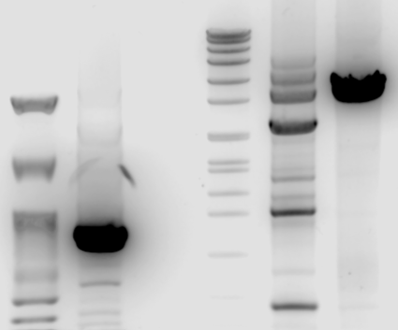
hDHCR7, hDHCR24 & hSC5D – primers test
Nippon 100pb
hDHCR7 fw1/rv1
Marker VII
hDHCR24 fw3/rv3
hSC5D fw6/rv6
8576
7427
6106
3’UTR | Size (bp) | miRNA site type
hDHCR7 | 871 | 7mer-m8
hDHCR24 | 2548 | 7mer-A1
hSC5D | 3425 | 8mer, 7mer-m8
4899
~3425bp
3639
3000
2799
1953
1882
1500
1515
1482
1164
1000
~871bp
992
900
710
500
400
300

